Slide 1
Supply Chain Management
The case study of Apple
By Chris Wong & Rui Qin

Slide 2
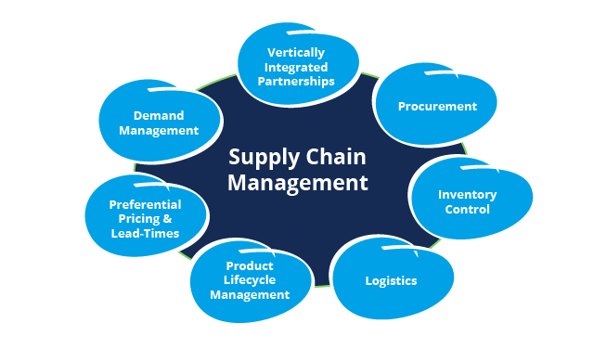
What is Supply Chain Management?
Flow of Goods and Services
Processes that turns raw material into final products.
Maximises customer value and competitive advantage in the market
Dfsm, 2021

Slide 3

Apple’s Inventory Management
Inventory Stock low and High inventory turnover
Inventory turnover ratio of 42.16 – Every 9 days
Competition
Helium10, 2021

Slide 4

Apple’s Inventory Management
Balance of Supply and Demand
Measured by Inventory turnover ratio to rate of production
High levels of sale without inventory waste
Tradegecko, 2021

Slide 5

Apple’s Strategic Relationships
Exclusive agreements with Suppliers
Competitive Pricing
Adaptability to production rates
Mitigation of Disruption to supply chain
Imd, 2021

Slide 6

Apple’s Strategic Relationships
Preventing competitors utilizing same production capacity
-Monopolies to prevent other big tech companies from copying their idea
Muic, 2021

Slide 7
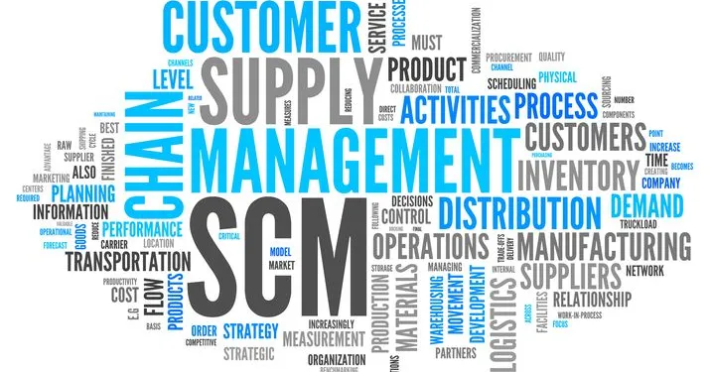
Conclusion
Attention to detail
Successful Supply Chain Management
Michiganstateuniversityonline, 2021

Slide 8
Image References
https://www.dfsm.com.au/dynamics-365-supply-chain-management/
https://www.helium10.com/tools/inventory-management/
https://www.tradegecko.com/inventory-management
https://www.imd.org/research-knowledge/articles/strategic-partnerships/
https://miuc.org/what-is-supply-chain-management/
https://www.michiganstateuniversityonline.com/resources/supply-chain/what-is-supply-chain-management/

